Slide 1

Mapping Tolkien
The Landscape and Literature of Fantasy

Slide 2
Cultural Impact
J.R.R Tolkien’s creation of a land of mystery and wonder has helped shape the “fantasy” genre as we know it today. His work is highly beneficial to studies based on a cartographic perspective.
Visual association helps interpret and understand literature in a unique way.
“The use of graphics along with text reinforces learning, in part because visual information is stored differently from verbal information in a student's memory” (Terence W. Cavanaugh)

Slide 3
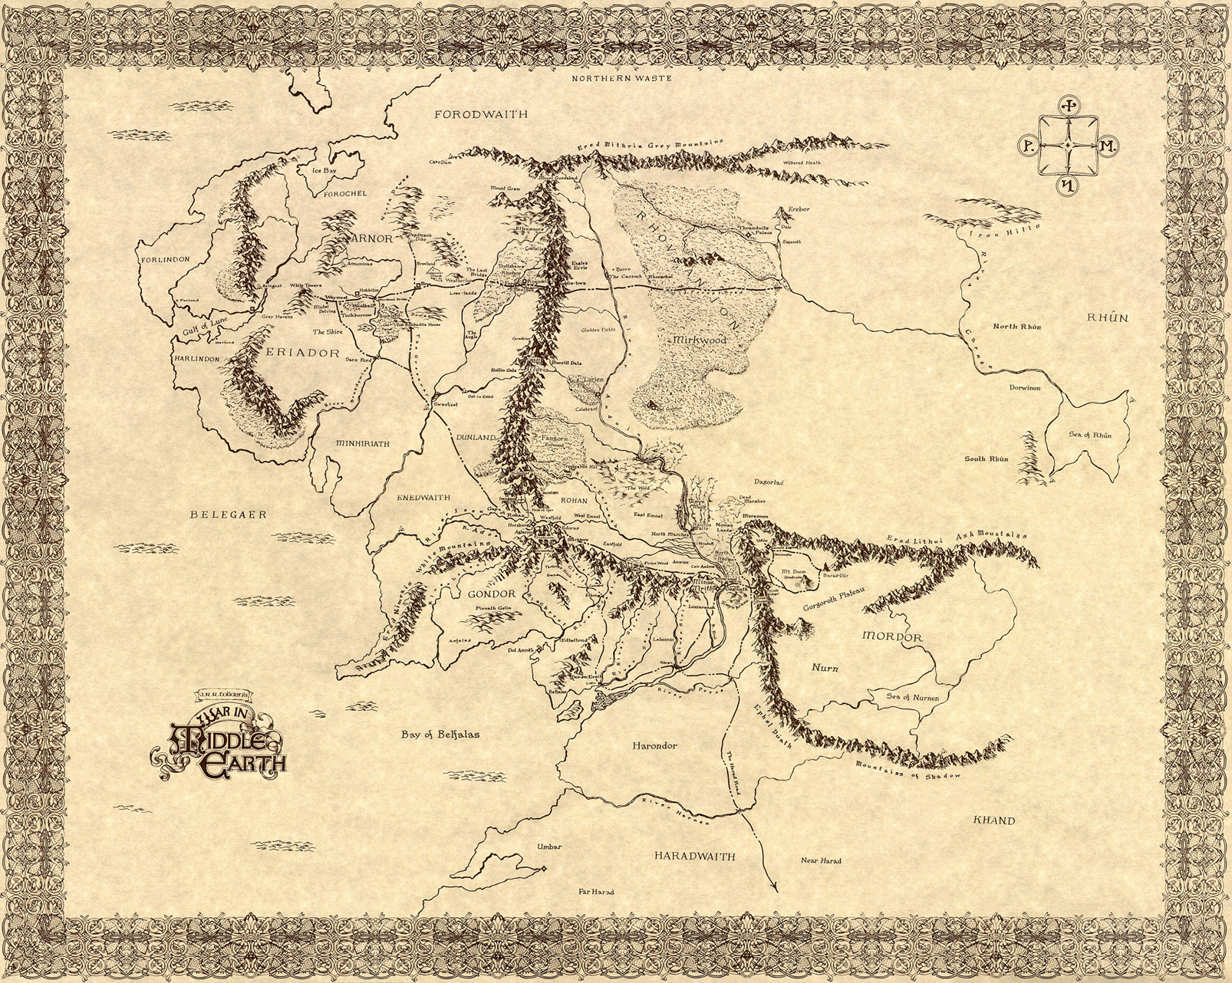
Middle Earth

Slide 4
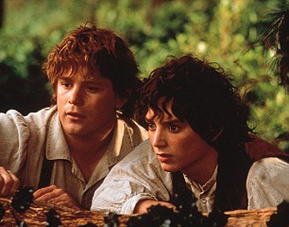
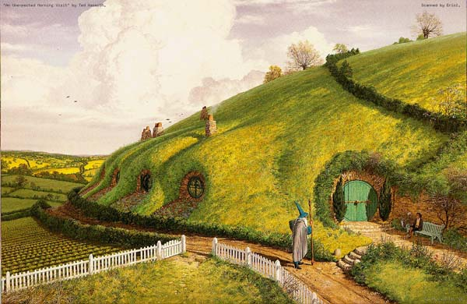
Tracing the Paths of the “Hero”
The Fellowship of the Rings follows the paths of various heroes, though for the purposes of this presentation I will be focusing on the journey of Samwise Gamgee and Frodo Baggins.

Slide 5
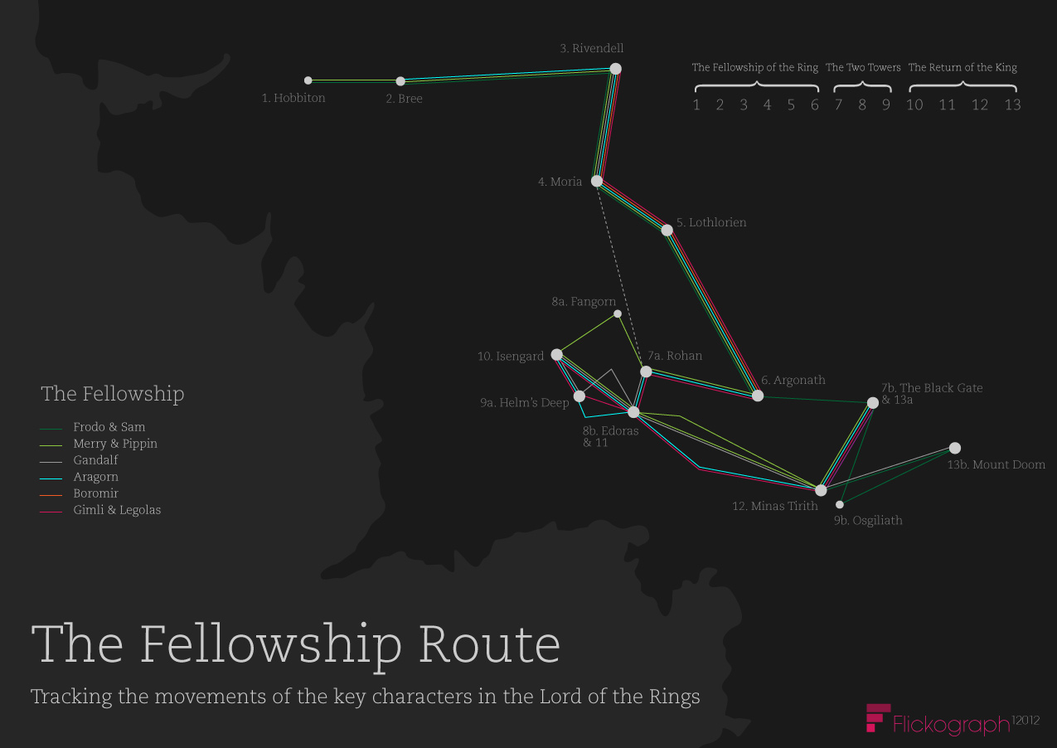
Overview of Journey

Slide 6
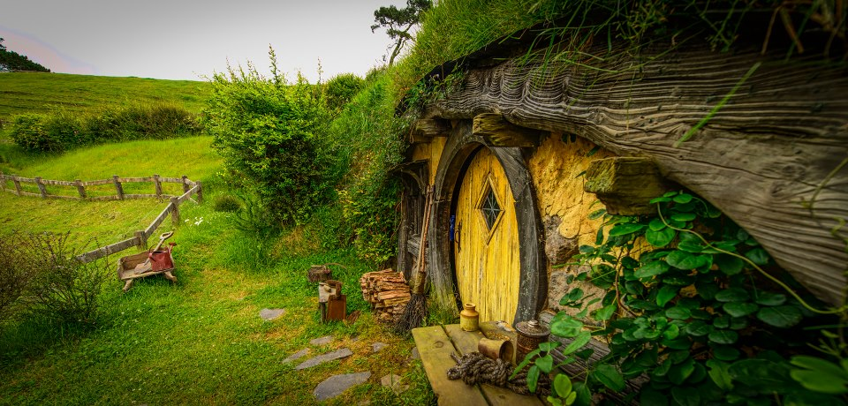
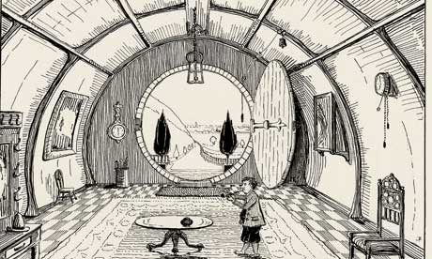
The Shire
The Great Years
Third Age
The Journey begins for Frodo in the Shire—
September 23- A Black Rider comes to Hobbiton at nightfall. Frodo leaves Bag End.
“Well, now we’re off at last!” Said Frodo. They shouldered their packs and picked up their sticks, and walked round the corner to the west side of Bag End. “Good-bye!” Said Frodo. (The Fellowship of the Rings, 78).
* Tolkien’s Illustration of Bag End

Slide 7
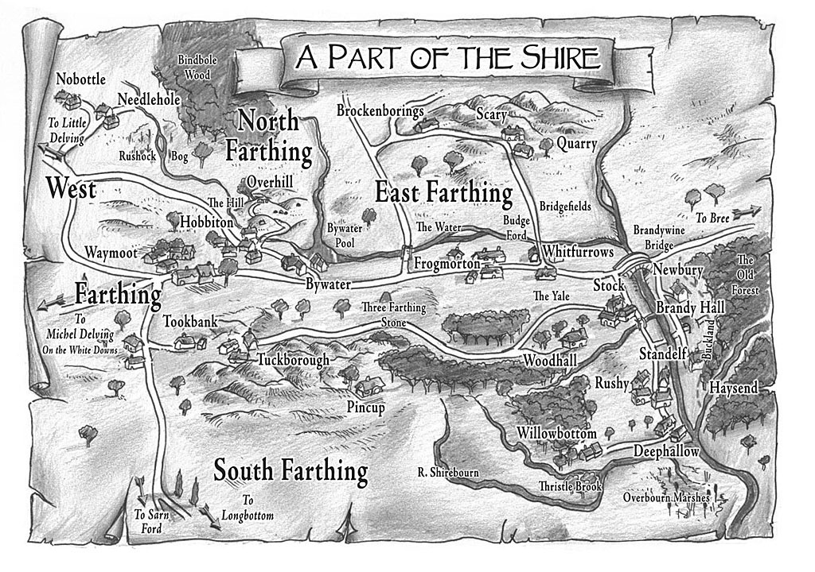

Slide 8
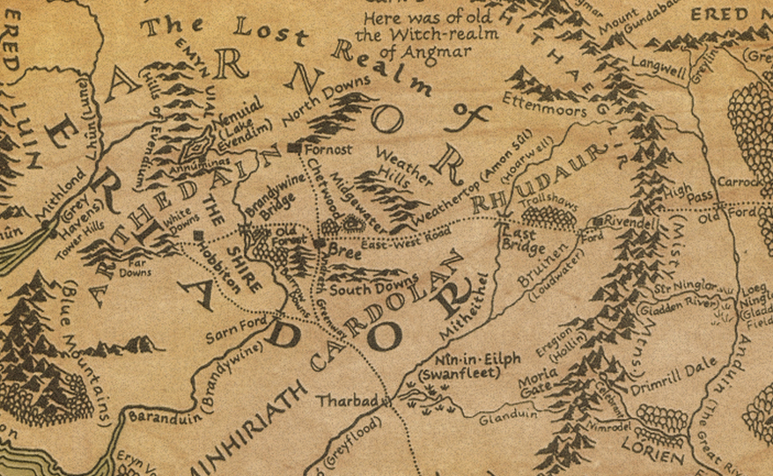
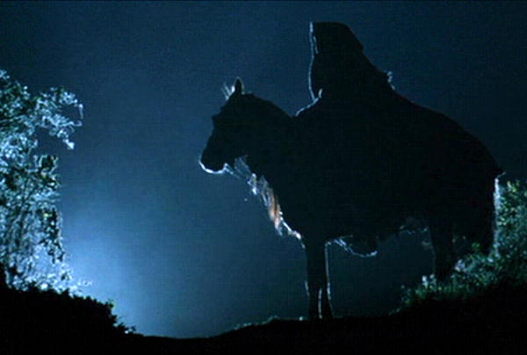
September
24- Encounter Nazgûl near Woody End
“…but a lane branched right, winding through wood of ancient oak-trees on its way to Woodhall. ‘This is the way for us,” Said Frodo (85)

Slide 9
September
25- Frodo, Sam and Pippin reach Crickhollow in the night and the conspiracy is unmasked
26- attacked by evil tree Old Man Willow and rescued by Tom Bombadil.
28- captured by a Barrow-wight
“Courage is found in unlikely places,’ Said Gildor. ‘Be of good hope’ (95)

Slide 10
September/ October
29th Reach Bree and stay at the Prancing Pony.
2nd Now traveling with Strider, the Hobbits journey through Midgewater Marshes
6th Reach Weathertop at noon.
13th Cross the Last Bridge
“Over the door was painted in white letters: THE PRANCING PONY by BARLIMAN BUTTERBUR. Many of the lower windows showed lights behind thick curtains” (173).

Slide 11
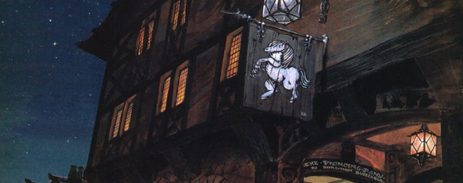
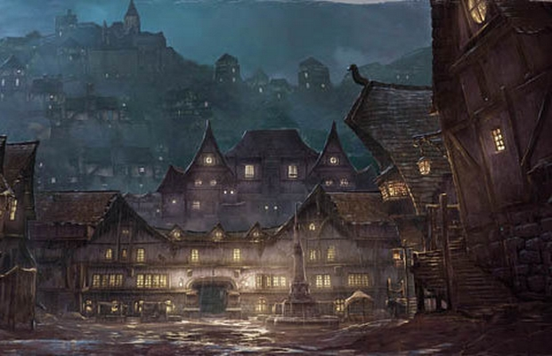
Prancing Pony, Bree

Slide 12
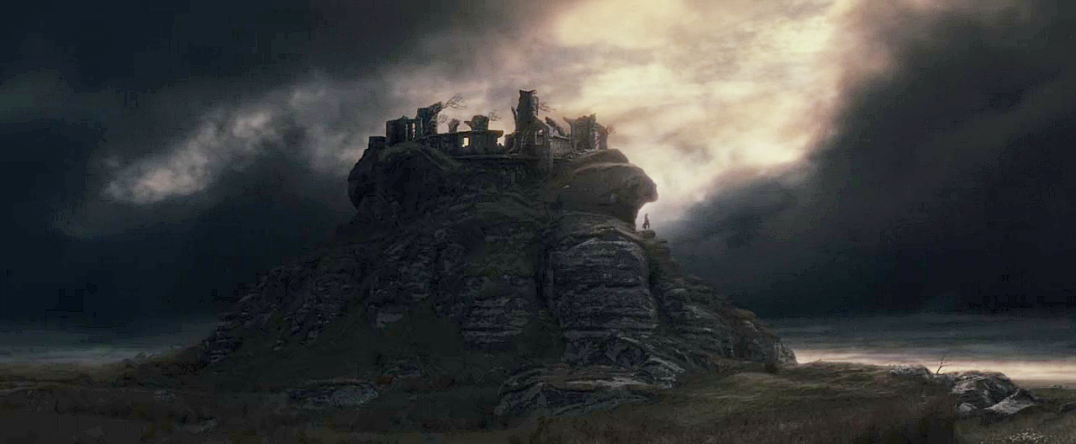
Weathertop

Slide 13
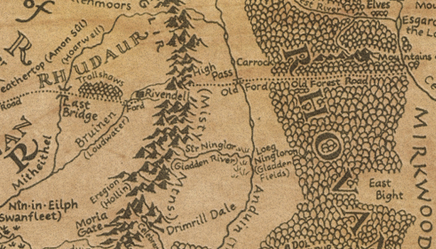
October/December
25th Council of Elrond held in Imladris
“What power still remains lies with us, here in Imladris” (298).
18th The members of the Fellowship are chosen
25th Fellowship leaves Rivendell.
“Then if the Ring cannot be kept from him for ever by strength,’ Said Glorfindel, ‘two things only remain for us to attempt: to send it over the Sea, or to destroy it”(298)

Slide 14
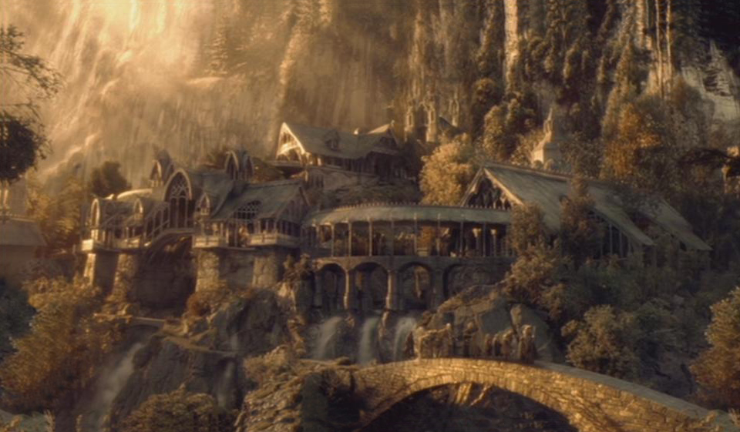
Imladris (Rivendell)

Slide 15
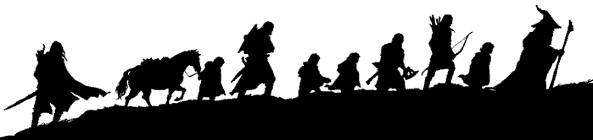
Fellowship Chosen
“I will take the ring,’ [Frodo] said, ‘though I do not know the way” (303)
“…It is a heavy burden. So heavy that none could lay it on another. I do not lay it on you. But if you take it freely, I will say that your choice is right…”
But you wont send him off alone surely, Master?” cried Sam… jumping up from the corner where he had been quietly sitting on the floor.
“No indeed!’ said Elrond, turning towards him with a smile. ‘You at least shall go with him. It is hardly possible to separate you from him, even when he is summoned to a secret council and you are not” (304)

Slide 16
January T.A. 3018
8th Fellowship reaches Hollin.
11th Fellowship tries to cross Pass of Caradhras
13th Fellowship reaches West-gate of Moria.
“There are the walls of Moria,’ Said Gandalf, pointing across the water. ‘And there the Gate stood once upon a time, the Elven Door at the end of the road from Hollin by which we have come” (338).

Slide 17
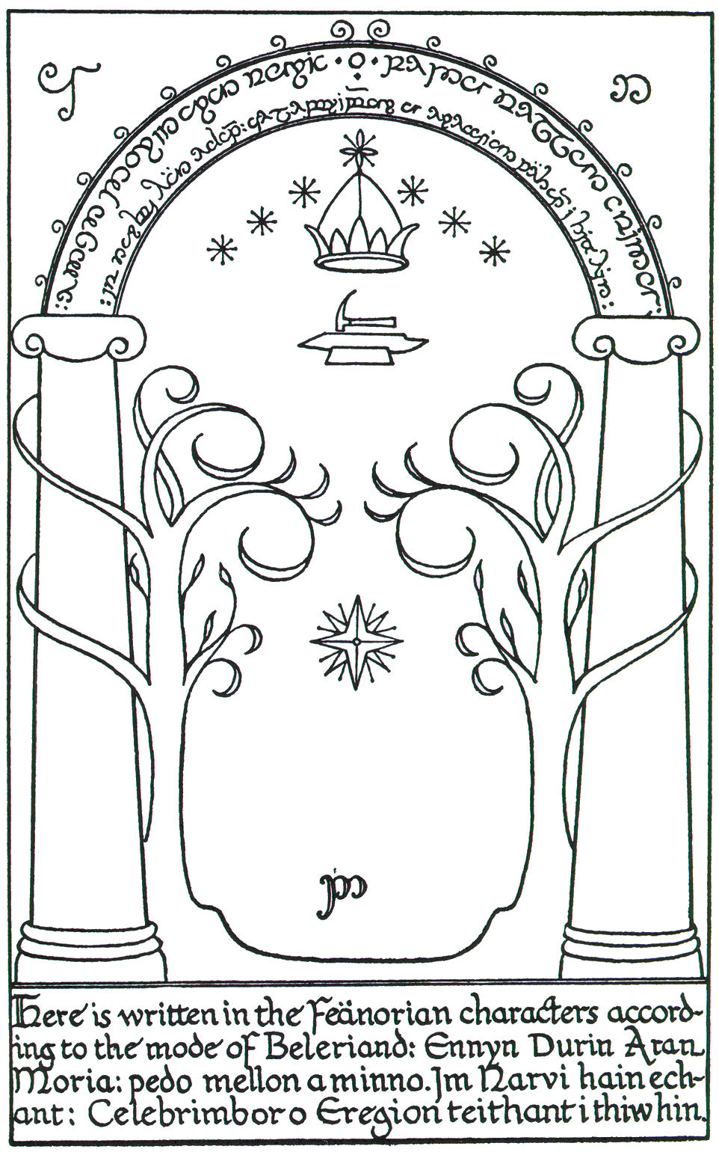
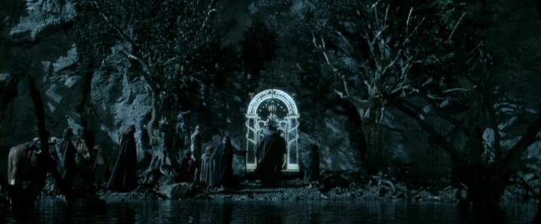
Moria

Slide 18
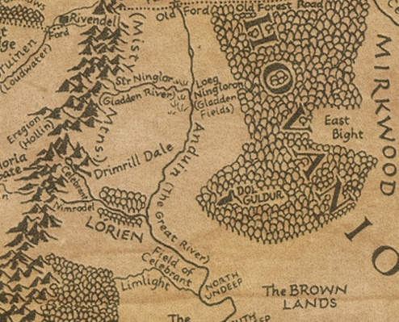
Janurary T.A. 3018
15th Fellowship reaches river Nimrodel; meets elves Haldir, Rúmil and Orophin.
15th Gandalf falls from Bridge of Khazad-Dûm with the balrog "Durin's Bane".
17th Company arrives at Caras Galadhon
“Welcome to Caras Galadhon!’ He said. ‘Here is the city of the Galadhrim where dwell the Lord Celeborn and Galadriel the Lady of Lorien. But we cannot enter here, for the gates do not look northward. We must go round to the southern side, and the way is not short, for the city is great” (396).

Slide 19
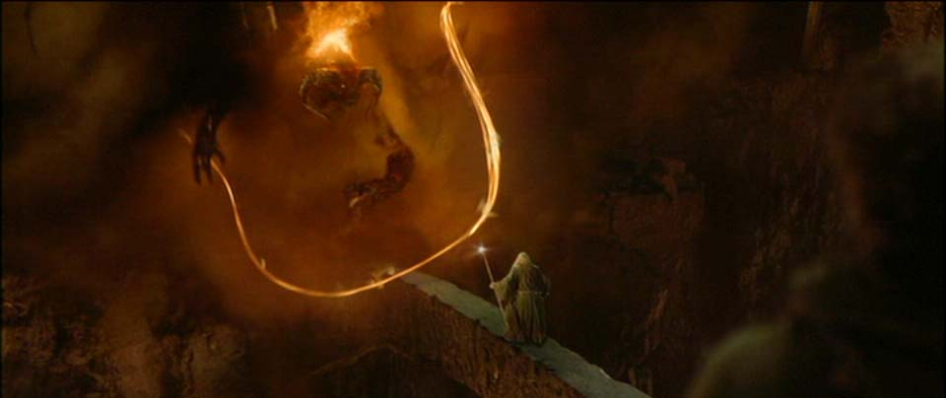
Bridge of Khazad-Dûm

Slide 20
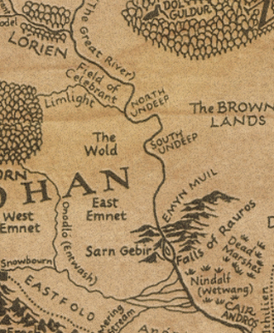
February T.A. 3018
15 Frodo is shown The Mirror of Galadriel.
16 Fellowship leave Lothlórien.
25th Fellowship passes the Argonath.
“Behold the Argonath, the Pillars of the Kings!’ Cried Aragorn… As Frodo was borne towards them the great pilalrs rose like towers to meet him. Giants they seemed to him, vast grey figures silent but threatening” (441).

Slide 21
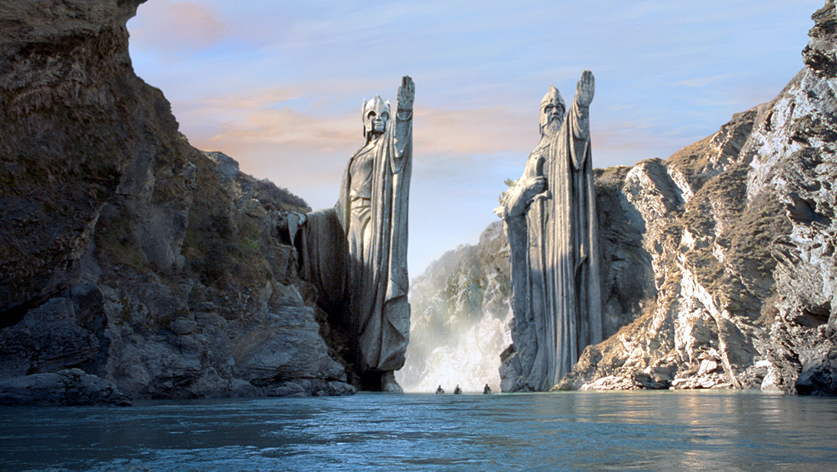
Argonath

Slide 22
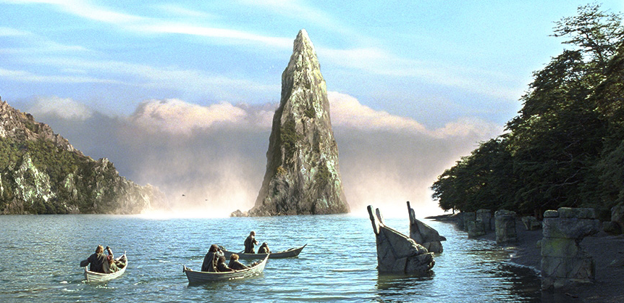
February T.A. 3018
26 - Breaking of Fellowship.
“So Frodo and Sam set off on the last stage of the Quest together. Frodo paddled away from the shore, and the River bore them swiftly away, down the western arm, and past the frowning cliffs of Tol Brandir” (457)

Slide 23
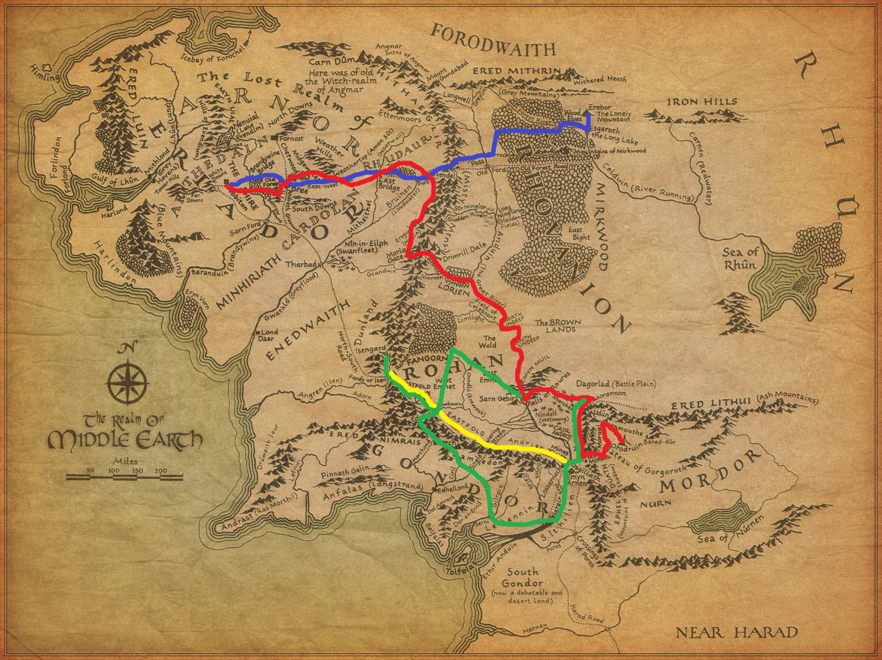
Journey

Slide 24
Reflection
When asked how the map informs the meaning of the text, it seems to me that you would have a difficult time telling this story without some sort of map, or geographic clues for the reader. The whole point and plot that drives the story forward is the quest—the hero’s journey, and Tolkien is asking the reader to be a part of this “Fellowship” and travel alongside Frodo to new and foreign lands. If he did not give the reader some sort of reference, or guide map, then the story would be hard to follow, and the reader would feel lost in a sea of names and places without connection. By laying out the path that we are to follow, the reader is allowed to truly engage with the text, and can visually see– and thereby “follow” along with the members of the Fellowship.

Slide 25
Reflection Continued
Tolkien would have had a hard time telling his story without the heavy use of maps, place names, and directions for the reader– or if he did tell the tale in that way, not very many people would be able to follow him.
I think the use of maps is crucially beneficially and because of this need, a world is created that envelopes the reader and takes them to a new world.
When creating an entirely new world, the author is asking the reader to fully commit to the reading experience and suspend their sense of reality– to engage in a new one. By giving the reader the maps needed for this journey to a new reality– Tolkien is saying, “Here is what you’ll need for this journey, now– Do you trust me?”

Slide 26
Reflection Continued
If the reader does– then they take the leap and have a map to guide their way. Without this lifeline of trust from the author, many people might find a story like this too difficult to begin.
The maps not only create a new plane of existence of the reader, but allows the characters to come to life as you watch them travel across a land that you can now follow. There is nothing more exciting than printing out the map from any of the Lord of the Rings books and placing pins in the names of places that you come across as you are reading the story. It is an entirely new level of interaction with literature, and I think it should be fostered in readers of all ages.

